Slide 1
Received Power Calculation in 3-D Space
Members
7106093049 安颯
7106064097 林韋頤

Slide 2
Outline
Introduction
Identification of the problem
Justification
Theory
Method
Result
Conclusion

Slide 3
Introduction
A prototype for Drive-Test
Received wireless power calculation
Here we see how signal propagate from Tx to Rx
We will see the possible transmitted signals reaching to Receiver
Computation based on simple geometric calculation
We try to learn an idea how we model a communication channel

Slide 4
Identification of the Problem
Drive-Test in real scenario is a bulky task
Drive-Test is done, pre and post manner recurrently
Drive-Test consumes huge manpower & investment

Slide 5
Justification
The Project aim is to model the parameters of Drive-Test
Reduce the cost of operation in Telecommunication Industry
This prototype just not only find the received Power at a particular place but also show the path travelled by the signal to reach particular receiver

Slide 6
Theory
This project is based on Multipath Fading
This prototype considered only LOS, First order reflection and Second order reflection
Fading in LOS < First order reflection < Second order reflection < Higher order reflection
First and Second order reflection ≈ 91% (.7+.7*.(1-.7)) of total contribution from reflected signals
We use omni-directional point transmitter

Slide 7
Method
Over all procedure
First order reflection
Second order reflection
Plot of transmitted signal(ray)

Slide 8
Over all procedure
Start
Input Rx & Tx location
Find image of (FOR,SOR) Tx on each plane
Compute distance between Rx-Tx︱Tx'︱Tx''
Compute received power
Find the path of Tx & Rx for LOS & FOR
Plot
Stop

Slide 9
First order reflection
Start
Find image using mid-point formula
Stop
Tx location
Find point on each plane
Find plane coefficient
Find point perpendicular to plane & Tx on plane

Slide 10
Tx
2D free space 50*50

Slide 11
Tx
Side squares are image of actual space; black wall acting as mirror

Slide 12
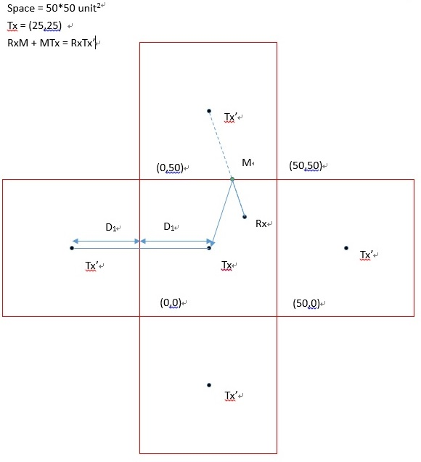
Distance between Tx & Rx is calculated for FOR

Slide 13
Second order reflection
Start
Exclude repeated Tx'' point
Stop
Tx location = Tx'
Find image Tx'' same as FOR

Slide 14
Plot of transmitted signal(ray)
Start
Draw line between Tx and Rx through reflection points
Stop
Tx,Rx,Plane coefficient
Find point of reflection from plane(using coordinate geometry)

Slide 15
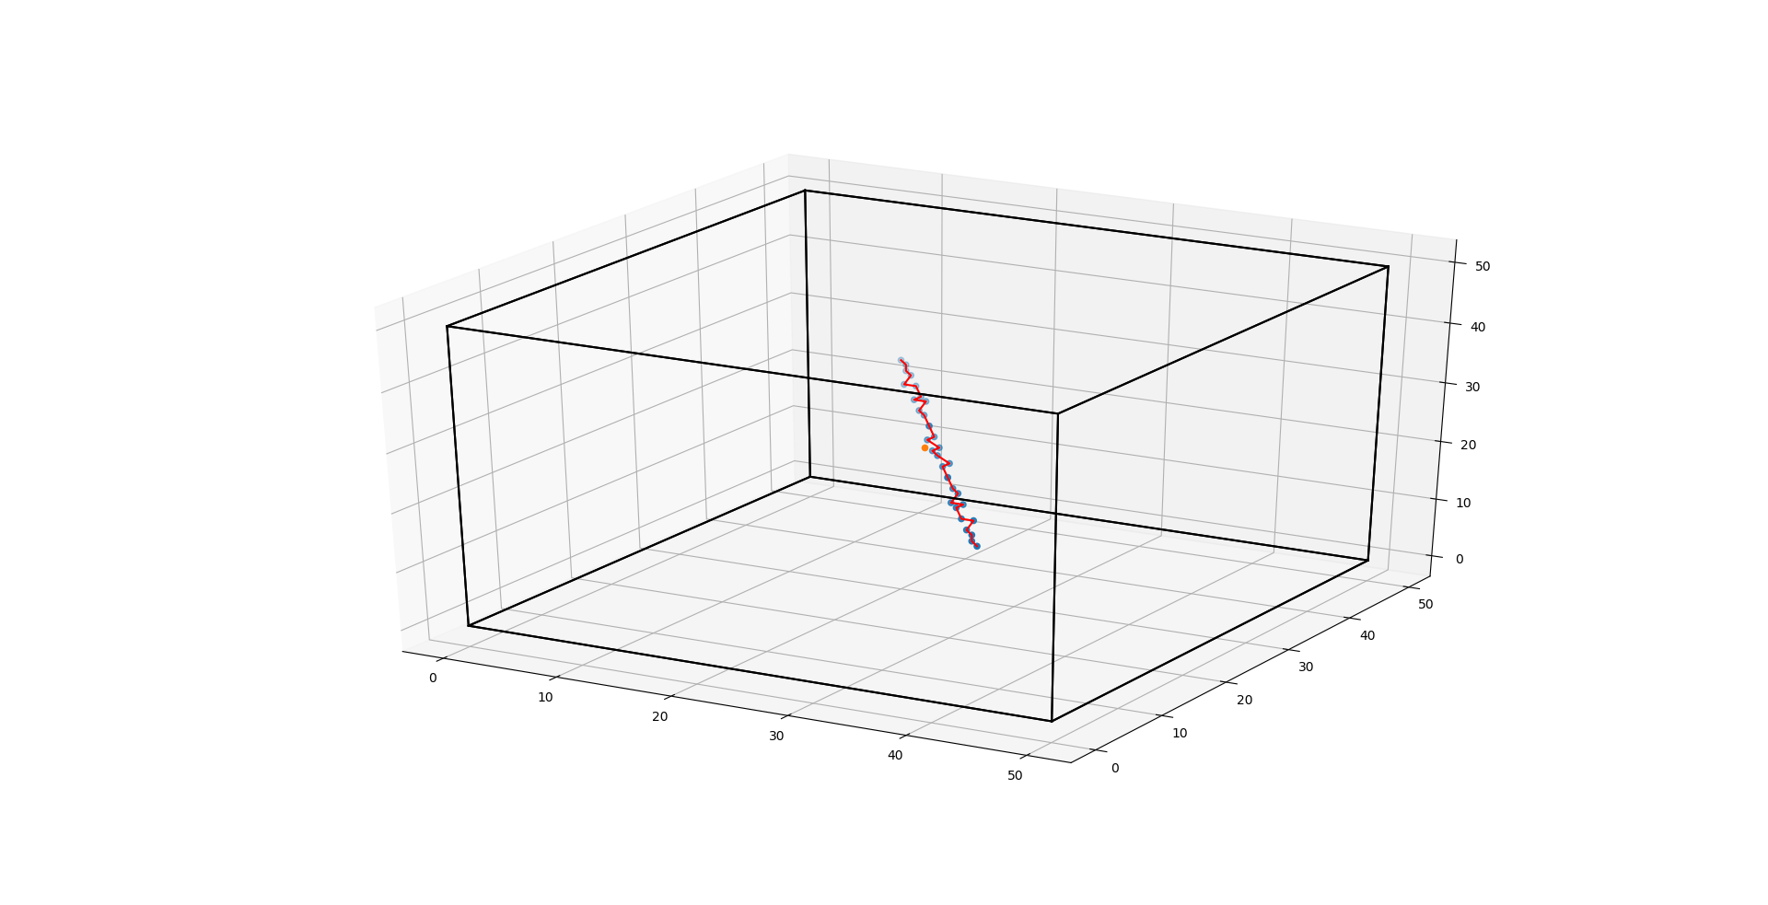
Our Result
Orange = transmitter
Blue = receiver
Red = receiver path
Representation of receiver path

Slide 16
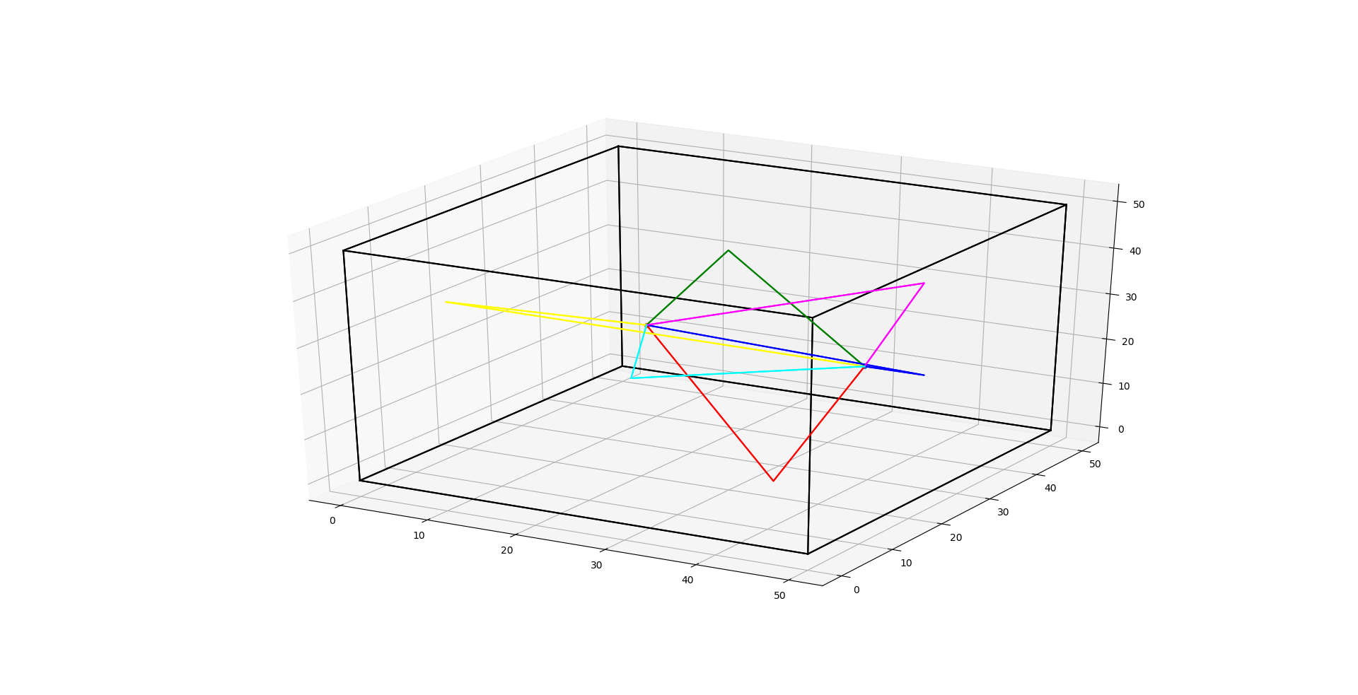
Signals from Tx to stationary Rx
Red = bottom
Green = top
Yellow = left
Blue = right
Pink = back
Cyan = front

Slide 17
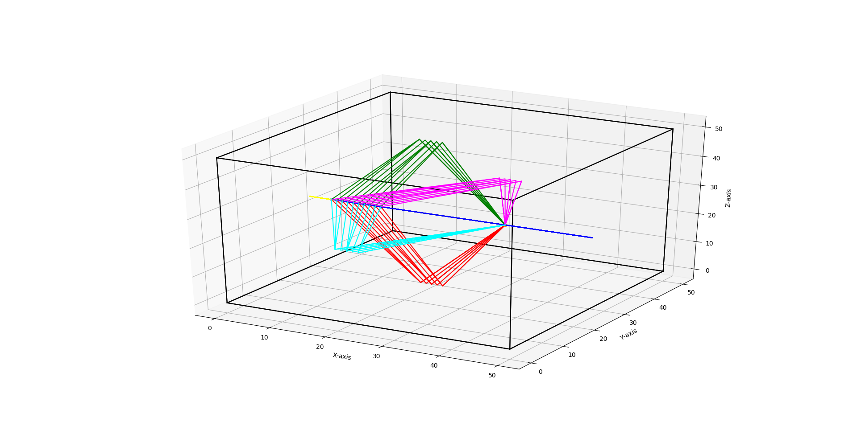
Signals from Tx to moving Rx

Slide 18
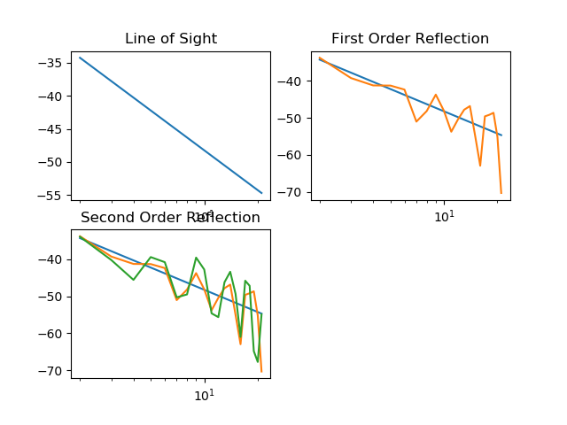
Semilog graph of receive power and distance

Slide 19
Benefits
A prototype for Drive-Test
Idea to model communication channel
Idea to predict transmission path
Idea to predict operative cell cluster
Future:
Find void space, poor coverage
Even can predict signal strength inside your bedroom if everything is model precisely

Slide 20
Conclusion
We learn use of strong computational library like numpy, matplotlib
We learn how drive test is done
We learn how can we model real world objects(like free space as communication channel in our case)

Slide 21
Thank you

Slide 22
Any questions?

